Slide 1


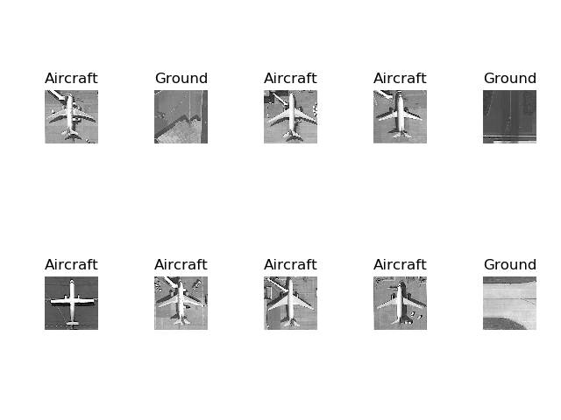
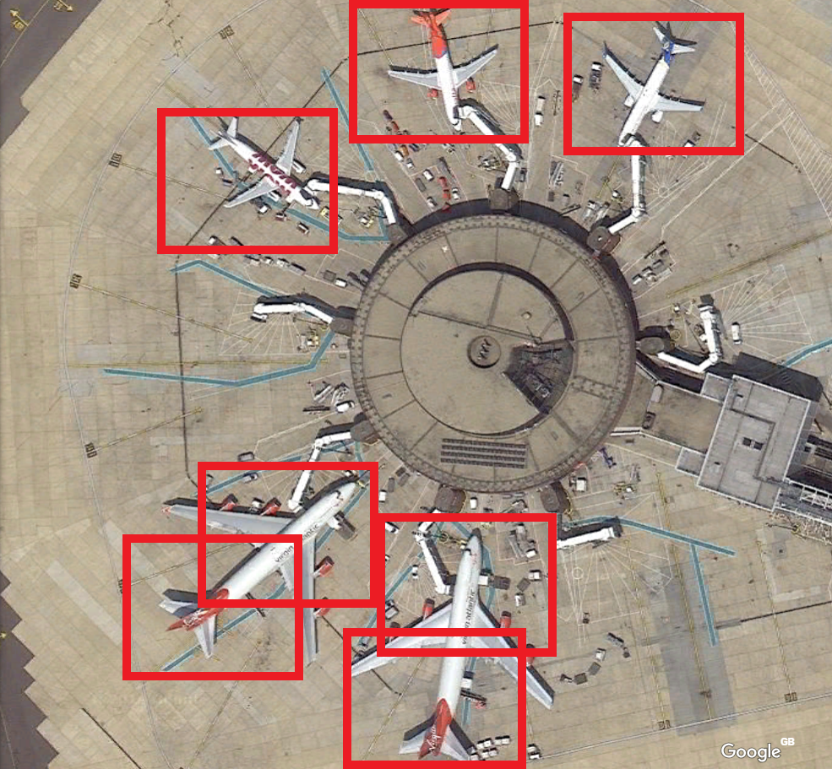
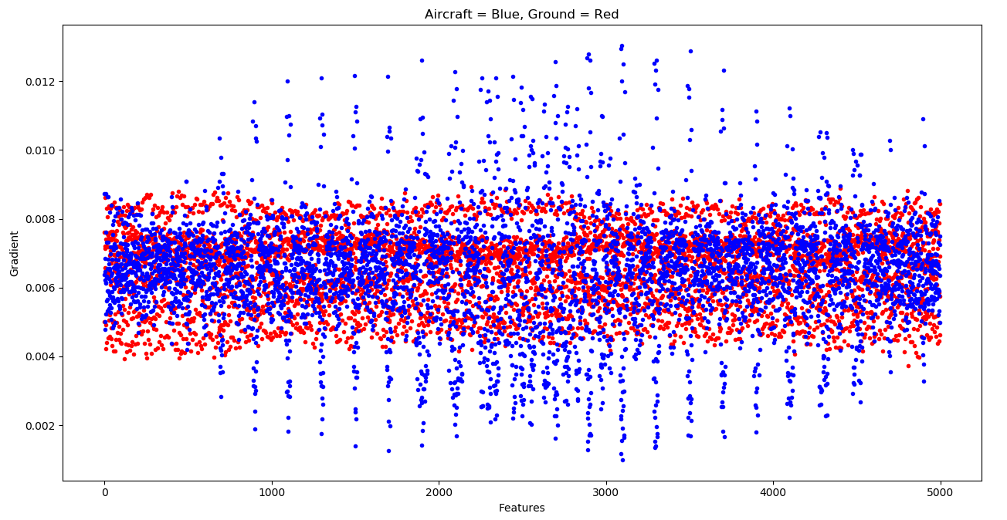
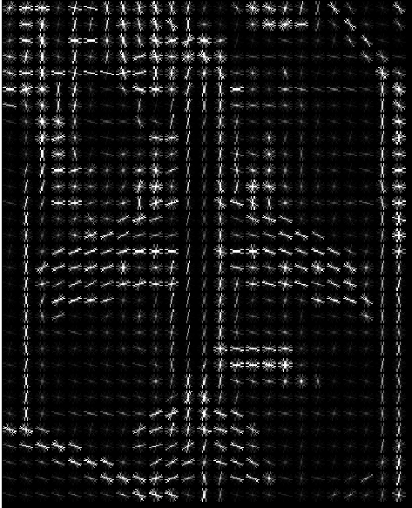
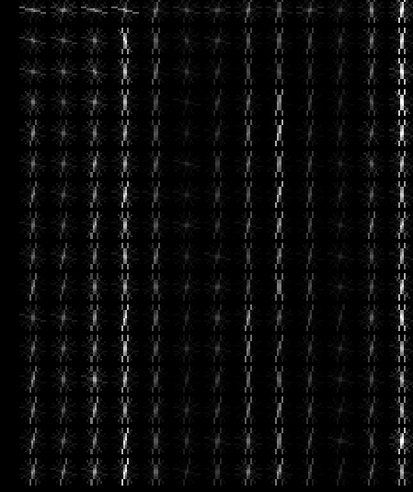
Identifying Aircraft from Above
Kai Roper-Blackman supervised by Sebastian Halder
Objectives
To allow a computer to differentiate between aircraft and ground images.
To identify aircraft of various sizes and orientations in a larger image, such as an airport and show their positions to the user.
Figure 1: Examples of standalone images used for training and classification
Methods
Pre-processing: Histogram of Oriented Gradients as shown in Figures 4 and 5 are used to obtain feature descriptors from images. Feature descriptors describe images mathematically to M
machine learning models.
Training and classification: A Support Vector Machine (SVM) takes training and test data, as shown in Figure 1, in the form of feature descriptors. The SVM evaluates a set of test images after training is complete and returns predictions with associated probabilities.
Figure 2 shows large image search results. The user defines search area size and increment values in pixels. As the search area moves closer to an aircraft, the aircraft probability slowly increases. The mid point of areas with increased aircraft probability are marked with a red square to indicate an area of interest to the user.
Figure 3: Visual representation of two feature descriptors. Red = Ground, blue = Aircraft
Figure 4 & 5 (left): Histogram of Oriented gradients on aircraft and ground image depicting direction of colour gradient
Figure 2: Search results from large image
Results
The large red squares in Figure 2 indicate the system predicts an aircraft is in that particular location.
Ground images have a low variance in gradient whereas Aircraft have a high variance.
Distribution of features in images of aircraft have higher spreads compared to ground images as shown in Figure 2
Detection of aircraft in larger images results in accuracy of 50%-60% as some aircraft are missed.
10 fold cross validation score of standalone images is 100%.

